Slide 1











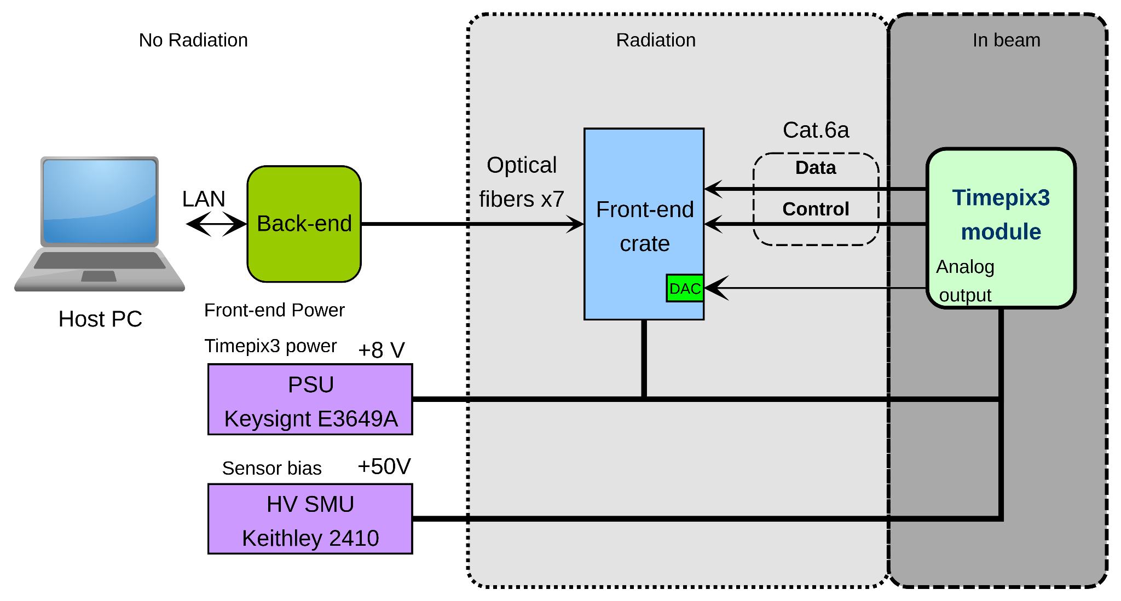
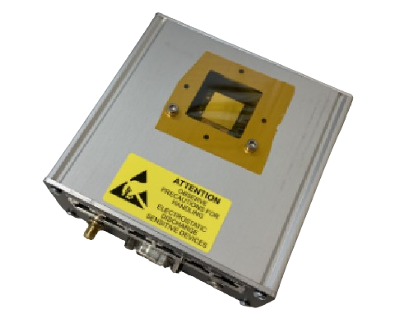
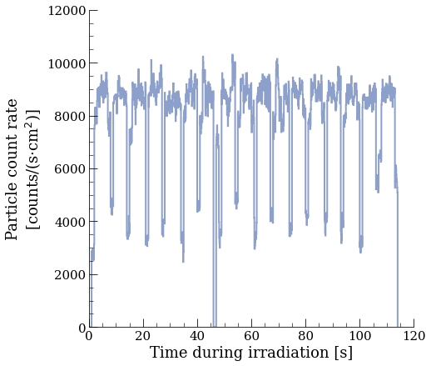
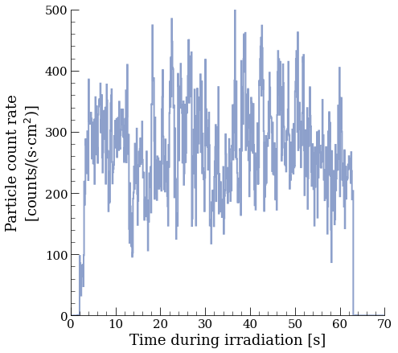
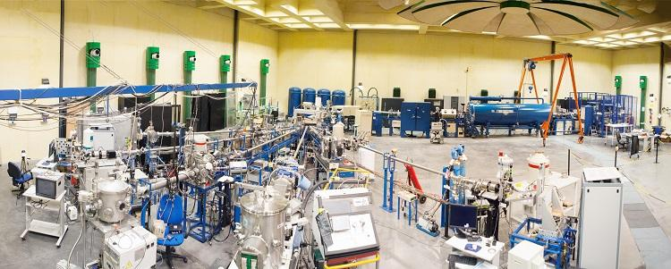
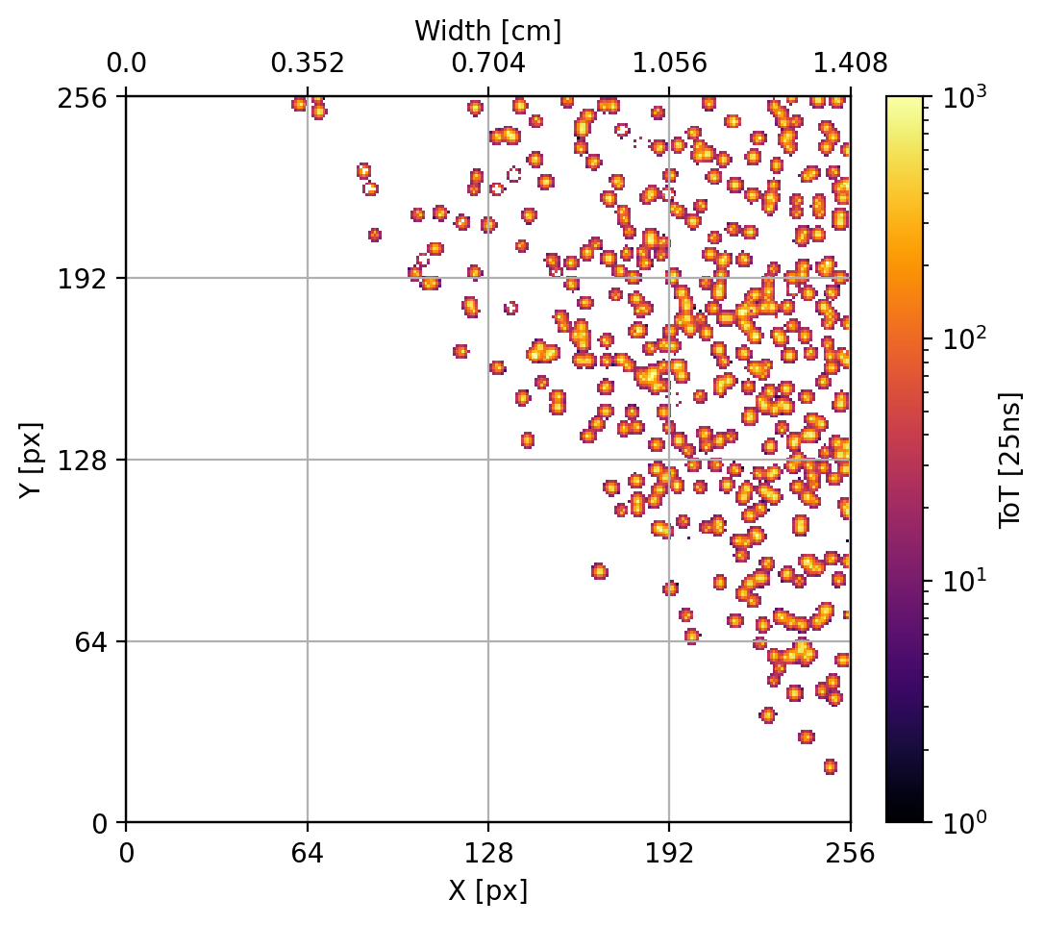
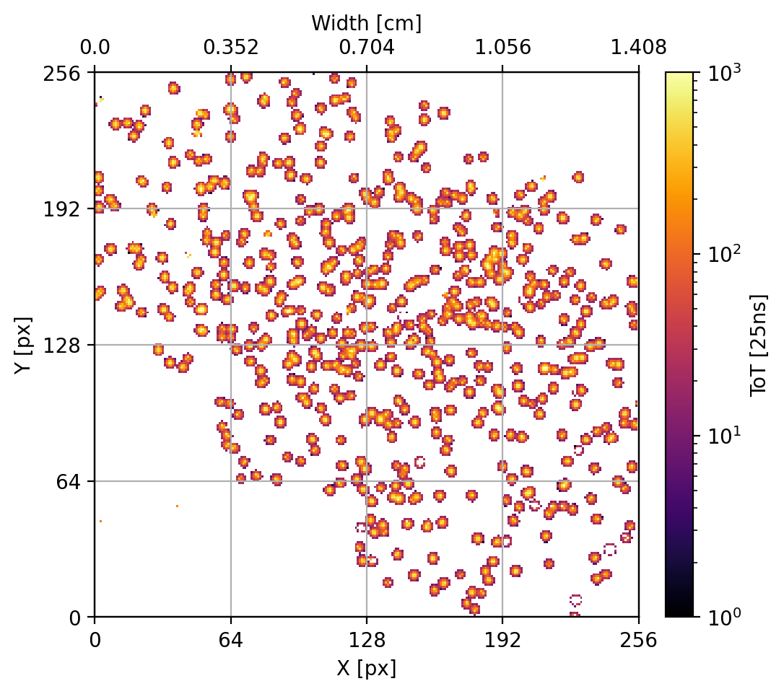
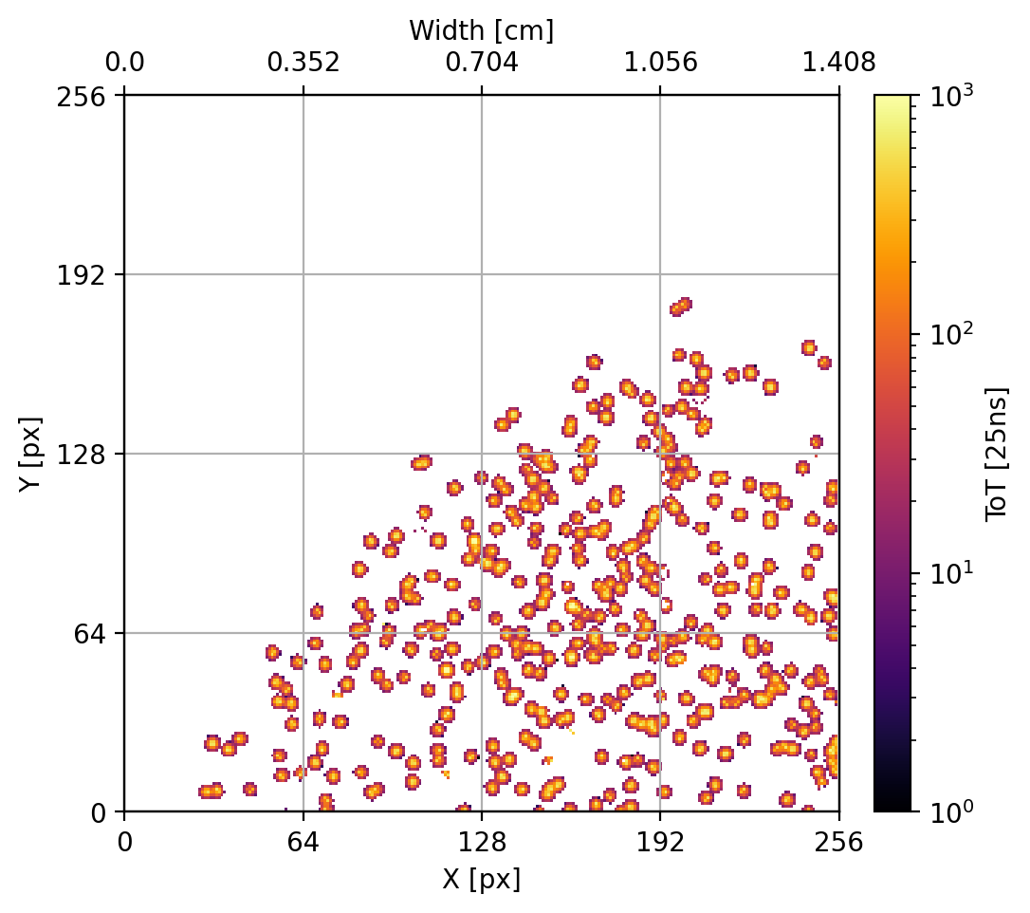
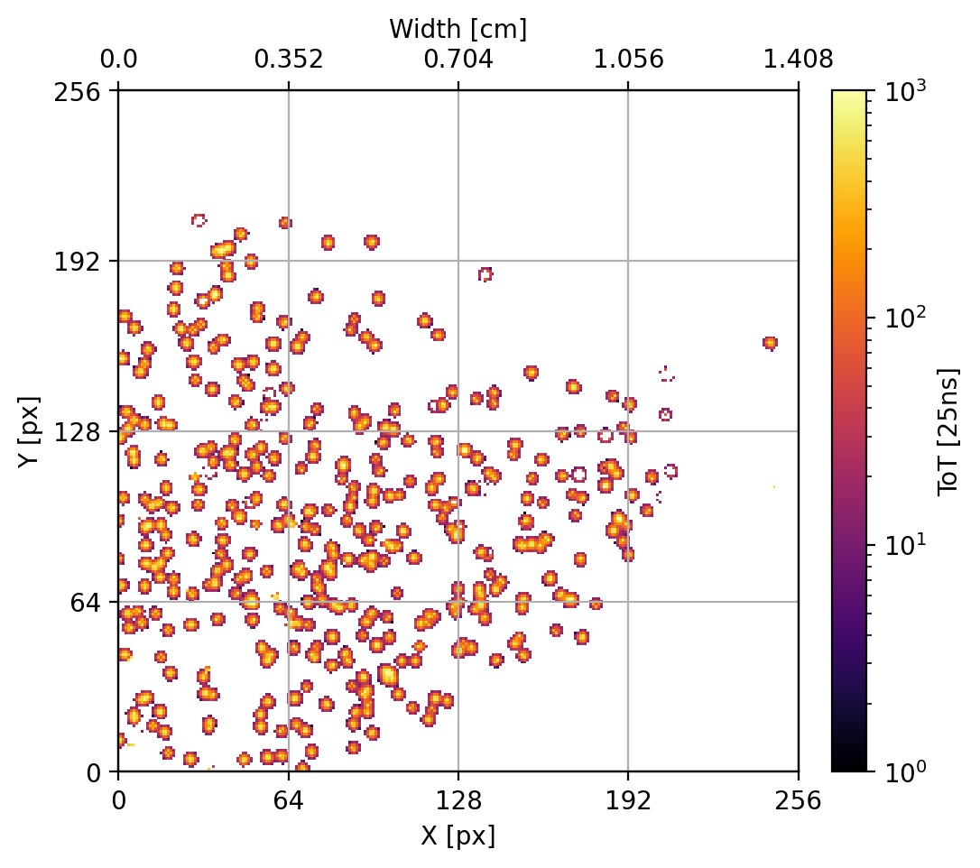
Low beam intensity raster scan measurements with the Timepix3 at CNA
Daniel Prelipcean^{1,2} (daniel.prelipcean@cern.ch), Ivan Slipukhin^{1,3}, Giuseppe Lerner¹, Rubén García Alía¹, Yolanda Morilla Garcia⁴, Amor Romero-Maestre⁴, Pedro Martin-Holgado⁴
¹European Organization for Nuclear Research (CERN, CH-1211 Geneva), ²Technical University of Munich (TUM, DE-80333 München), ³University of Montpellier (UoM, FR-34090 Montpellier), ⁴Centro Nacional de Aceleradores, Universidad de Sevilla, CSIC (CNA, ES-41092 Sevilla)
1. The Timepix3 Radiation Monitor
3. Low intensity beam measurement limitations
With an increasing number of applications, the Timepix [1] technology is also currently studied as a possible radiation monitor [2] within the scope of the Radiation to Electronics (R2E) activities at the CERN. During a calibration campaign at CNA, at the 3 MV tandem facility [3], the Timepix3 detector`s capabilities as a beam monitor for ion beams emerged. The investigated proton and hadron beams leave multi-pixel tracks in the Timepix3 sensor, and after reconstructing the full clusters, the beam shape, size, intensity and its movement could be measured.
A scintillator is used for live flux monitoring in the irradiation chamber. It is based on a sample holder assembly biased at 200-300 V, with an aluminum variable slit in front, and it is electrically insulated from the rest of the line. This assembly collects the secondary electrons and is connected to a current integrator with the purpose of monitoring the flux in a Faraday Cup configuration. The lower limit of this instrument for a reliable current measurement is roughly 50 pA, translating to a minimum flux of 10⁶ particles/(s cm²).
For the Timepix3 campaign, it was requested to use a particle flux below the lower limit of the scintillator, to avoid pile-up events in the physical detector and in the clustering algorithm. In addition, the raster scanning system was used to spread the beam over larger areas, thereby reducing the local flux. Although this is limited by the sample holder dimensions (16×20 cm²), depending on the beam features the full range can be further increased. During the campaign, a local flux density of around 10⁴ particles/(s cm²) was typically used, but it was also decreased down to 10² particles/(s cm²). In these conditions, no live flux monitoring is provided by the facility.
Timepix3 sensor Silicon, 300 µm
Fig. 1: (Left) Schematic diagram of the Timepix3 Radiation Monitor used in R2E, with the Timepix3 module (right) to be placed in beam or in a radiation hard area; the front-end crate can also withstand limited radiation damage, while the back-end and control laptop should be in a radiation safe area (e.g. the control room).
4. Beam flux measurements
2. CNA 3MV tandem facility
When the entire beam is aimed at the detector, the measured (cluster reconstructed) particle count rate in Fig. 3 (Left) reveals plateaus at 10⁴ particles/(s cm²), as requested. Moreover, one can observe valleys in the measured count rate, corresponding to the raster scan: the frequency of the magnets can be adjusted, so that the beam can be tuned to cover the same route every 20 seconds, guaranteeing the homogeneity of the raster scan.
At the present time, the CNA 3MV Tandem facility has six available beam lines to characterize and to modify materials, as well as for Nuclear Physics research. The test campaign was performed on the +15° Beam Line: Irradiation Chamber. This home-made scattering chamber has been designed to allow the irradiation of large areas by raster scanning of the beam through magnetic deflection. On this beamline, on the first portable support, a cubic assembly and the beam scanning system are placed. The cube accommodates two main elements: i) a 45º pentaprism, which allows to better check the DUT position, and ii) a variable graphite slit which defines the beam size (usually they are selected to obtain a 1 cm² beam spot size). For large areas, the special shape of this piece avoids the undesirable production of radiation coming from the collision of the beam with the pipe walls. For the purpose of sweeping uniformly the beam over the sample surface, a magnetic beam scanning system is in place, which consists of two magnets for horizontal and vertical scanning. The vacuum chamber for the irradiation (p=10⁻⁶ mbar) is located at the end of the line.
Fig. 3: Timepix3 Radiation Monitor measured particle count rate, (Left) confirming the requested beam intensity of 10⁴ particles/(s cm2) for alpha particles at 1 MeV, and (Right) the lowest requested flux for protons at 3 MeV.
When the intensity decreases below the scintillator threshold, one loses the instantaneous information about the raster scan, but the beam spot size of 1x1cm² is assumed to be maintained. Thanks to the pixel array of the Timepix3, this has also been confirmed by the detector results in Fig. 4., moreover showcasing the raster scan by displaying two sides of the diamond.
Fig. 2: CNA beam lines at the 3MV tandem laboratory.
Fig. 4: Particle hits on the Timepix3 Radiation Monitor in different time windows, confirming the displacement of the beam due to the raster scan procedure, with protons at 3 MeV. Similar plots can be made for the other beam configurations.
References
5. Conclusions
T. Poikela et al., Timepix3: a 65k channel hybrid pixel readout chip with simultaneous ToA/ToT and sparse readout, in Journal of Instrumentation 9 (2014), pp. C05013–C05013. doi:10.1088/1748-0221/9/05/c05013.
D. Prelipcean et al., Towards a Timepix3 Radiation Monitor for the Accelerator Mixed Radiation Field: Characterisation with Protons and Alphas from 0.6 MeV to 5.6 MeV. in Applied Sciences. 2024; 14(2):624. doi:10.3390/app14020624.
Y. Morilla et al., Progress of CNA to become the spanish facility for combined irradiation testing in Aerospace, in 2018 18th European Conference on Radiation and Its Effects on Components and Systems (RADECS), IEEE, 2018. doi:10.1109/RADECS45761.2018.9328656.
C. Cazzaniga et al., Measurements of Low-Energy Protons Using a Silicon Detector for Application to SEE Testing, in: IEEE Transactions on Nuclear Science 69.3 (2022), pp. 485–490. doi:10.1109/TNS.2021.3123814.
The Timepix3 radiation monitor successfully measured beam fluxes below the current lower limit of 10⁶ particles/(s cm²), given by a scintillator instrument. It confirms the requested flux from the facility of 10⁴ particles/(s cm²) in the absence of the live monitoring, down to a particle-by-particle measurement. Moreover, thanks to its pixel matrix, it confirms as well the raster scan procedure. A Si diode has also been used in the past for monitoring the flux in the complementary range 10²-10⁶ particles/(s cm²) [4], but without providing information about the beam spot site or raster scan procedure. This work suggests that the Timepix3 detector is suitable as a beam monitor instrument.

